Slide 1
Fixed point Division
Computer System Architecture
By
M. Morris Mano

Slide 2
Example (Paper and Pencil Method)
1
1
0
1
0
Quotient = Q
Divisor:
B = 1 0 0 0 1
0 1 1 1 0 0 0 0 0 0
Dividend = A
0 1 1 1 0
5 bits of A < B, quotient has 5 bits
0 1 1 1 0 0
6 bits of A ≥ B
1 0 0 0 1
Shift right B and subtract; enter 1 in Q
0 1 0 1 1 0
6 bits of remainder ≥ B
1 0 0 0 1
Shift right B and subtract; enter 1 in Q
0 0 1 0 1 0
Remainder < B, enter 0 in Q; shift right B
0 0 1 0 1 0 0
Remainder ≥ B
1 0 0 0 1
Shift right B and subtract; enter 1 in Q
0 0 0 1 1 0
Remainder < B, enter 0 in Q
Final remainder: 000110

Slide 3
Division (Paper and Pencil Method)
Division of two fixed point binary numbers in signed magnitude representation is done by successive
  Compare
  Shift
  Subtract operations.
Binary division
  Simpler than decimal division because quotient digits are either 0 or 1.
  There is no need to estimate how many times the dividend or partial reminder fits into the divisor.

Slide 4
Division (Paper and Pencil Method)
Divisor B consists of 5 bits and Dividend A of 10 bits.
The 5 MSB of A are compared with the B.
Since the 5 bit number is smaller than B , we take 6th MSB and compare A > B, so we place 1 for the Quotient in the 6th position above dividend.
B is then shifted to one place right and subtracted from A.
The difference is called a partial remainder.
The process will continued by comparing a partial remainder with B.
If partial remainder ≥ B ,then Q bit is equal to 1 and B is shifted one place right and subtracted.
If partial remainder < A, then Q bit is 0 and no subtraction is needed, B is shifted one place right.
Result gives both Q and R.

Slide 5
Hardware Implementation for signed magnitude data
Simplified division algorithm:
Instead of shifting the divisor to the right, the dividend and partial remainder, is shifted to left, thus leaving two numbers in the required relative position.
Subtraction may be achieved by adding A to the 2’s complement of B.
End-carry (E) - Contains information about the relative magnitudes.
H/w for implementing division is identical to that for multiplication.
Register EAQ is now shifted to the left with 0 inserted into Q_{n} and the previous value of E lost.

Slide 6
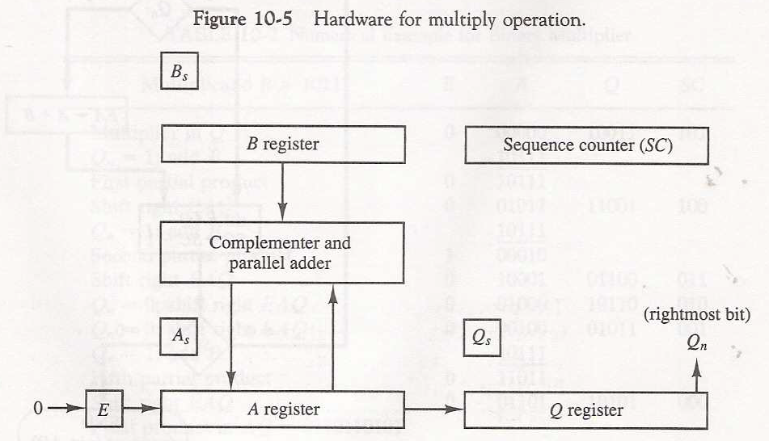
Hardware for divide operation

Slide 7
Divide Algorithm
Divisor is stored in B register.
Double length dividend is stored in registers A and Q.
Dividend is shifted to left.
If E=1it indicates A≥B;
  Divisor is subtracted by adding its 2’s complement value.
  A quotient bit 1 is inserted into Q_{n}(=1).
If E=0 it indicates A<B;
  Divisor is subtracted by adding its 2’s complement value.
  If E=0, it indicates A<B
    So that quotient in Q_{n}(=0)
    Value of B is then added to restore the partial remainder in A to its previous value.
  If E=0, insert 1 to Q_{n.}
Decrement the SC value and repeat.
Partial remainder shifted to left.
Process repeated until all 5 Q bits are formed.

Slide 8
Divide Algorithm cont…
While partial remainder is shifted left, the quotient bits are also shifted.
After 5 shifts, quotient is in Q and final remainder is in A.
Sign of the quotient is determined from the signs of the dividend and divisor.
If signs are same, sign of quotient is (+).
If signs are different, sign of quotient is (-).
Sign of the remainder is the same of the dividend.

Slide 9
Hardware algorithm for division
Store dividend in A and Q, and divisor in B.
Sign of result is transferred into Q_{s}.
SC = no. of bits in quotient.
A divide overflow condition is tested by subtracting divisor in B from half of the bits of the dividend in A.
If A ≥ B - DVF(=1) is set. Operation is terminated.
If A<B - no DVF(=0). Value of dividend is restored by adding B to A.
Division algorithm starts by shifting the dividend in AQ to the left with the high order bit shifted into E.

Slide 10
Hardware algorithm for division
If shift operation inserts 0 to E, the divisor is subtracted by adding 2‘s complement and the carry is transferred to E.
If E=1; A>=B; Q_{n}=1.
If E=0 ; A<B and the original no. is restored by adding B to A.
In the latter case leave a 0 in Q_{n}.
This process is repeated again with reg. A holding the partial remainder.
After n-1 times, the quotient magnitude is formed in Q and the remainder is in A.
The sign of Q is in Q_{s} and the sign of remainder is in A_{s} is the same as the original sign of the dividend.

Slide 11
Signed magnitude Division Flow chart
Divide operation
Divide magnitudes
Dividend in AQ
Divisor in B
Shl EAQ
Q_{S} ← A_{S} + B_{S}
SC ← n – 1
= 0
E
= 1
EA ← A + B + 1
EA ← A + B + 1
A ← A + B + 1
= 1
A ≥ B
= 1
= 0
E
E
Q_{n} ← 1
A ≥ B
A < B
A < B
= 0
EA ← A + B
EA ← A + B
DVF ← 1
EA ← A + B
DVF ← 0
SC ← SC – 1
SC
≠ 0
END
(Divide Overflow)
= 0
END (Quotient in Q, Remainder in A)

Slide 12
Signed – Magnitude Division
Divisor B = 10001
B + 1 = 01111
Comment
E
A
Q
SC
Dividend:
0 1 1 1 0
0 0 0 0 0
5
Shl EAQ
0
1 1 1 0 0
0 0 0 0 0
Add B + 1
0 1 1 1 1
E = 1
1
0 1 0 1 1
Set Q_{n} = 1
1
0 1 0 1 1
0 0 0 0 1
4
Shl EAQ
0
1 0 1 1 0
0 0 0 1 0
Add B + 1
0 1 1 1 1
E = 1
1
0 0 1 0 1
Set Q_{n} = 1
1
0 0 1 0 1
0 0 0 1 1
3
Shl EAQ
0
0 1 0 1 0
0 0 1 1 0
Add B + 1
0 1 1 1 1
E = 0, leave Q_{n} = 0
0
1 1 0 0 1
0 0 1 1 0
Add B
1 0 0 0 1

Slide 13
Divisor B = 10001
B + 1 = 01111
Comment
E
A
Q
SC
Restore remainder
1
0 1 0 1 0
2
Shl EAQ
0
1 0 1 0 0
0 1 1 0 0
Add B + 1
0 1 1 1 1
E = 1
1
0 0 0 1 1
Set Q_{n} = 1
1
0 0 0 1 1
0 1 1 0 1
1
Shl EAQ
0
0 0 1 1 0
1 1 0 1 0
Add B + 1
0 1 1 1 1
E = 0, leave Q_{n} = 0
0
1 0 1 0 1
1 1 0 1 0
Add B
1 0 0 0 1
Restore remainder
1
0 0 1 1 0
1 1 0 1 0
0
Neglect E
Remainder in A:
0 0 1 1 0
Quotient in Q
1 1 0 1 0

